Slide 1
How to take control of your taxes and make the most of your retirement
VUL Optimizer® Max
Month 00, 2024
Life Insurance: • Is Not a Deposit of Any Bank • Is Not FDIC Insured • Is Not Insured by Any Federal Government Agency
• Is Not Guaranteed by Any Bank or Savings Association • Variable Life Insurance May Go Down in Value

Slide 2
1
Plan today for the tax efficiency
you want tomorrow

Slide 3
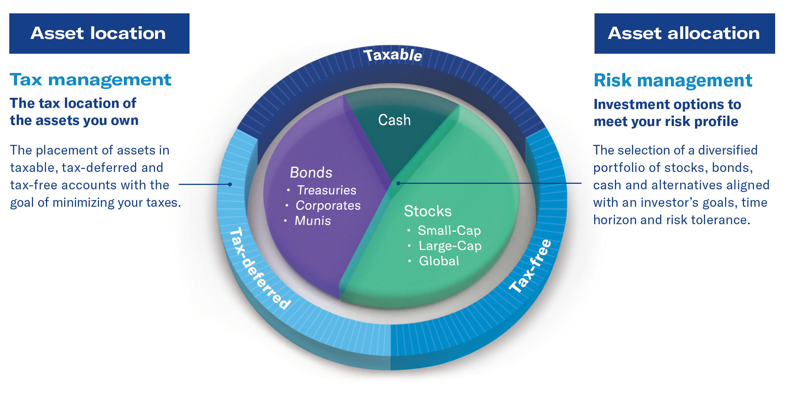
Take control of your taxes
See how setting up an asset location strategy today can help you manage your taxes in the future
No one is sure what will happen with taxes in the future. That’s why it’s so important to set up a strategy today that can help you take control of your taxes in the future, add flexibility to your tax situation and help you keep more of what you earn.
VUL Optimizer® Max – Month 00, 2024
3
Notes:
You may be familiar with the concept of asset allocation – diversifying your investments across a variety of asset classes. While an asset allocation strategy is an important way to help manage risk while your money is invested, it won’t help you manage your taxes when you start taking income in retirement. That’s where an asset location strategy comes in. By investing your assets in different financial products (or locations) that have different tax consequences, you can help improve the tax efficiency of your portfolio and maximize your after-tax retirement income.

Slide 4
Not all products are created “tax-equal”
Building wealth
Generating income in retirement
Brokerage accounts
CDs
Money market funds
Savings
Brokerage accounts
CDs
Money market funds
Savings
401(k), 403(b) pension plans
Traditional IRA
Taxable
Taxable
401(k), 403(b)
Pension plans
Traditional IRA
Tax-deferred
Tax-exempt municipal bonds
Roth IRAs
Fixed life insurance
Variable universal life
Tax-exempt municipal bonds
Roth IRAs
Fixed life insurance
Variable universal life
Tax-free
Tax-free
VUL Optimizer® Max – Month 00, 2024
4
Notes:
When you’re building wealth, the products you use can either be taxable, tax-deferred, or tax-free. When you generate income from those assets, the money you receive will either be taxable or income tax-free. Optimally, you’ll want the benefits of tax-deferred assets as you build wealth and income that is tax-free, when you retire.

Slide 5
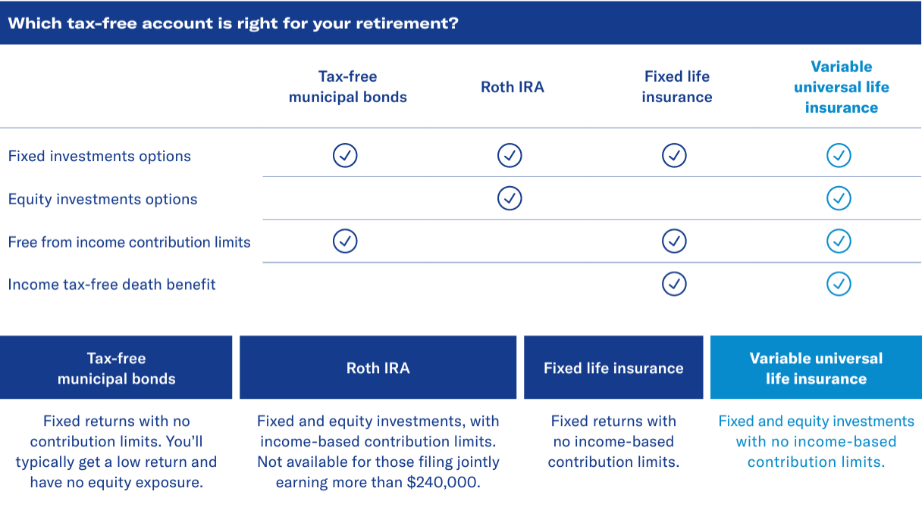
Each income tax-free investment has different benefits
VUL Optimizer® Max – Month 00, 2024
5
Notes:
There are four main types of financial products that produce tax-free income: municipal bonds, Roth IRAs,fixed life insurance and variable universal life insurance. Each has different benefits to consider. Which one(s)could help you achieve your retirement goals?

Slide 6
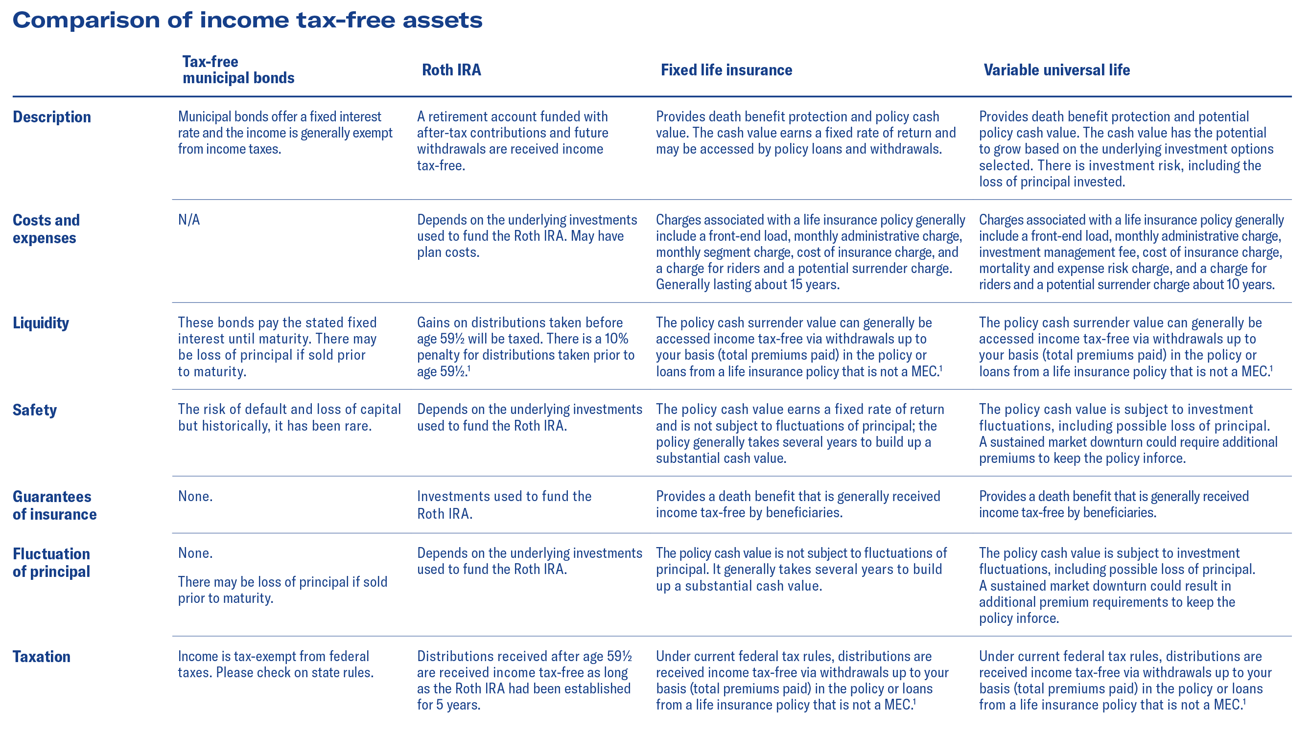
Comparison of tax-free assets
1 Loans and withdrawals reduce the policy’s cash value and death benefit, may cause certain policy benefits or riders to become unavailable, and increase the chance the policy may lapse. You may need to pay higher premiums in later years to keep the policy from lapsing. If the policy lapses, is surrendered or becomes a Modified Endowment Contract (MEC), the loan balance at such time would generally be viewed as distributed and taxable under the general rules for distribution of policy cash values.
Under current federal tax rules, you generally may take federal income tax-free withdrawals up to your basis (total premiums paid) in the policy or loans from a life insurance policy that is not a MEC. Certain exceptions may apply for partial withdrawals during the policy’s first 15 years. If the policy is a MEC, all distributions (withdrawals or loans) are taxed as ordinary income to the extent of gain in the policy, and may also be subject to an additional 10% premature distribution penalty prior to age 59½, unless certain exceptions are applicable.
Please remember cash value life insurance does have other considerations you should review carefully before selecting a life insurance policy. Please keep these important points in mind and review with your financial professional:
If you do not keep paying the premium on a life insurance policy, you will lose substantial money in early years.
To be effective, you need to hold the policy until death. A life insurance policy generally takes years to build up a substantial cash value.
You must qualify medically and financially for life insurance, unlike a Roth IRA.
VUL Optimizer® Max – Month 00, 2024
6
Notes:
There are four main types of financial products that produce tax-free income: municipal bonds, fixed life insurance and variable universal life insurance. Also, a Roth IRA which is an IRA plan designed to facilitate retirement savings can produce retirement income. Each has different benefits to consider. Which one(s) could help you achieve your retirement goals?

Slide 7
Managing your tax bracket
Life insurance to protect against tax rate ups and downs
It’s always important to diversify and spread your risk among many investments.
Diversification can help protect you from fluctuations among different assets and asset classes.²
Need life insurance
Think taxes will increase
Need more retirement income than Social Security, their IRAs and other current savings can provide
Already maximum fund their 401(k)s and IRAs
The problem:
Rosie and Bennett are a middle-aged couple. They’re saving for retirement but need to care for their children and plan for college. Bennett is also looking at life insurance to help protect the family in case something happens to him. At the same time, the couple is funding their IRAs and 401(k)s, but know these won’t address all they need for retirement.
2 Diversification is a method of asset allocation. It does not guarantee a profit or protect against a loss. A diversified method of investing may result in a loss of principal to the investor.
VUL Optimizer® Max – Month 00, 2024
7
Notes:
Read Slide

Slide 8
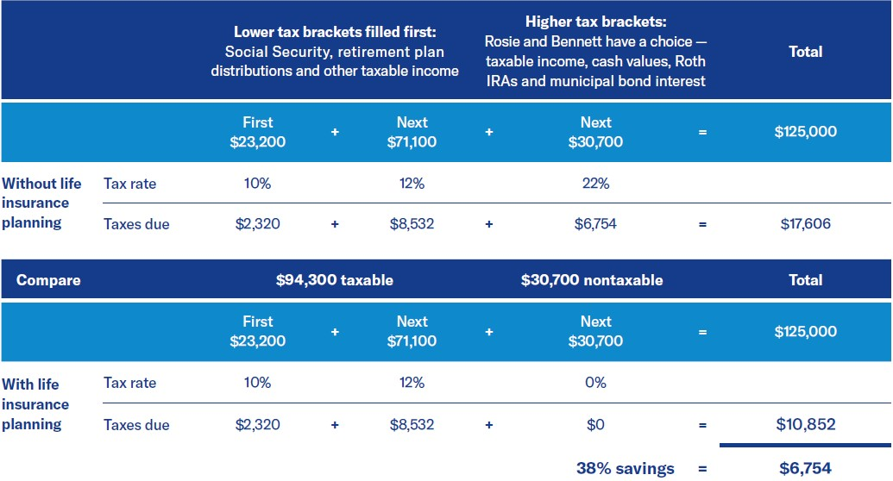
Managing your tax bracket
The chart shows how Rosie and Bennett fill their higher tax brackets.³ Once they take $94,300 in income, the next dollar they take will be taxed at 22%. They need an additional $30,700 to meet their pretax income goal of $125,000. They will pay $6,754 in taxes if they take the $30,700 from taxable income (retirement plan distributions and other taxable income). They will pay $0 in taxes if they take the $30,700 from nontaxable income (life insurance cash value, Roth IRA and municipal bond interest).
A possible solution
Carl, their financial professional, shows them an option — cash value life insurance. It offers Rosie and Bennett:
Death benefit protection in case something happens to Bennett during his working years.
Access to policy-available cash surrender values that grow tax-deferred.
During the couple’s retirement years, any available cash surrender value can be taken from the life insurance policy via withdrawals and loans. So long as the life insurance remains inforce, the funds can be received income tax-free.
The couple can use these tax-free withdrawals and loans to supplement income in years they need added income without increasing their tax bracket.³
Withdrawals and loans from life insurance policies are exempt from the 3.8% Medicare surcharge.
A final added benefit
Life insurance cash values, along with the couple’s IRA and 401(k) accounts, aren’t included in the expected family contribution calculations for college financial aid.
Rosie and Bennett have a number of sources of income to meet their $125,000 target income, but they’re worried about taxes. Each year they will take nondiscretionary payments, such as Social Security and their required distributions, from taxable retirement funds. This fills up their lower tax brackets totaling $94,300 and paying $10,852 in taxes.
3 Loans and withdrawals reduce the policy’s cash value and death benefit, may cause certain policy benefits or riders to become unavailable, and increase the chance the policy may lapse. If the policy lapses, is surrendered or becomes a Modified Endowment Contract (MEC), the loan balance at such time would generally be viewed as distributed and taxable under the general rules for distribution of policy cash values. If the policy is a MEC, all distributions (withdrawals or loans) are taxed as ordinary income to the extent of gain in the policy and may also be subject to an additional 10% premature distribution penalty prior to age 59½, unless certain exceptions are applicable.
VUL Optimizer® Max – Month 00, 2024
8
Notes:
Read Slide:
The chart shows how Rosie and Bennett fill their higher tax brackets.3 Once they take $81,050 in income, the next dollar they take will be taxed at 22%. They need an additional $18,950 to meet their income goal of $100,000. They will pay $4,345 in taxes if they take the $18,950 from taxable income (IRA, pension distributions, other taxable income). They will pay $0 in taxes if they take the $18,950 from non-taxable income (life insurance cash value, Roth IRA and municipal bond interest).

Slide 9
Some considerations before
moving ahead:
Carefully review all the features, benefits and costs of a cash value life insurance policy with your financial professional before making a purchase. There are many other differences between Roth IRAs, municipal bonds and permanent life insurance.
If your life insurance policy lapses, you will lose the death benefit and may lose substantial money in the early years. To be effective, you need to hold the policy until death. A life insurance policy generally takes years to build up a substantial cash value.
Tax-free distributions will reduce the cash value and face amount of the policy. You may need to pay higher premiums in the later years to keep the policy from lapsing.
You must qualify medically and financially for life insurance.

Slide 10
2
VUL Optimizer® Max

Slide 11
Consider VUL Optimizer® Max
If you’re looking for more ways to invest growth-oriented assets you’ve earmarked for retirement, VUL Optimizer® Max provides a potential strategy. It’s a tax-deferred variable universal life (VUL) insurance strategy specifically designed to help you create tax-efficient retirement income and protect your family throughout your lifetime with tax-deferred growth.
Benefits of VUL Optimizer® Max
This strategy provides death benefit protection and maximizes your other retirement savings, with:
Flexible access to potentially tax-deferred growth
No contribution limits for investing
Potential tax-free retirement income when you decide to take withdrawals
A digital experience from end to end, with no labs, no exams and no attending physician statement (APS)
Underwriting that happens in 48 hours if you qualify
Variable universal life (VUL) is a type of life insurance that has the potential to build cash value. When you make payments, you can invest your money in a wide variety of investment options. VUL Optimizer® Max is designed to help provide future income for you and your family, so you may want to fund the policy with higher premiums in the early years to take advantage of growth potential and compounding interest. VUL Optimizer® Max also pays a life insurance death benefit that can be used to replace income or cover expenses.
There are fees and charges associated with variable life insurance policies, including mortality and risk charges, administrative fees, investment management fees, front-end load, surrender charges and charges for optional riders. Additionally, variable universal life insurance and its riders have restrictions and limitations.
Loans and withdrawals reduce the policy’s cash value and death benefit, may cause certain policy benefits or riders to become unavailable, and increase the chance the policy may lapse. If the policy lapses, is surrendered or becomes a Modified Endowment Contract (MEC), the loan balance at such time would generally be viewed as distributed and taxable under the general rules for distribution of policy cash values. If the policy is a MEC, all distributions (withdrawals or loans) are taxed as ordinary income to the extent of gain in the policy, and may also be subject to an additional 10% premature distribution penalty prior to age 59½, unless certain exceptions are applicable.
VUL Optimizer® Max – Month 00, 2024
11

Slide 12
VUL Optimizer® Max
The prospective applicant for this strategy
If you’re looking to generate retirement income and diversify your taxes in the future, VUL Optimizer® Max may be a good strategy for you.
Age range: 20-55
Has a need for life insurance of up to $2,000,000 face amount
Routinely goes to wellness visits
Healthy, active lifestyle
Limited use of prescription medications
U.S. citizen or permanent resident residing permanently in the United States
Has contributed the maximum amount to their 401(k) and has assets in the ranges shown to fund supplemental retirement income
 | Male |  | Female
Age | Minimum annual premium | Maximum annual premium | Minimum annual premium | Maximum annual premium
25 | $3,700 | $70,600 | $3,000 | $57,100
30 | $4,200 | $80,200 | $3,400 | $64,900
35 | $4,700 | $91,500 | $3,900 | $74,100
40 | $5,400 | $105,100 | $4,400 | $85,100
45 | $6,200 | $121,100 | $5,100 | $98,300
50 | $7,200 | $140,700 | $5,900 | $114,300
55 | $8,400 | $164,600 | $6,900 | $133,900
Annual premium amounts are based on the Guideline Premium Test and Death Benefit Option B (Option B death benefit equals the policy’s face amount, plus account value) at issue. If using the cash value accumulation test (CVAT) and Death Benefit Option A (Option A death benefit equals the policy’s face amount), these premiums may be different. The minimum premium columns represent the necessary premium to qualify for VUL Optimizer® Max at the minimum face amount of $100,000 and the maximum premium columns represent the necessary premium to qualify for VUL Optimizer® Max at the maximum face amount of $2,000,000. The numbers have been rounded for simplicity.
To determine how this approach might work for you, individual illustrations based on your own individual age containing both guaranteed charges and guaranteed interest rates, as well as other important information, should be prepared or requested for your review. Your financial professional can provide you a copy of the individual illustration.
VUL Optimizer® Max – Month 00, 2024
12
Notes:
Read Slide.

Slide 13
What does a typical client look like?
Clients typically wouldn’t have a history of these conditions:⁴
The ideal client build for VUL Optimizer® Max looks like:
Alcohol and/or drug misuse
Heart condition
COPD/emphysema
Diabetes
DWI
License suspension
Reckless driving
Epilepsy/seizure
Gastric bypass/lap band
Hepatitis
Kidney disease
MS
Nicotine use in the last 12 months
Parkinson’s disease
Psychological disorder
Sleep apnea
Stroke
Height (ft) | Weight (lbs) | Height (ft) | Weight (lbs)
4'8" | 145 | 5’8’’ | 214
4'9" | 150 | 5’9’’ | 220
4'10" | 155 | 5’10’’ | 227
4'11" | 161 | 5’11’’ | 233
5’0’’ | 166 | 6’0’’ | 240
5’1’’ | 172 | 6’1’’ | 247
5’2’’ | 178 | 6’2’’ | 253
5’3’’ | 184 | 6’3’’ | 260
5’4’’ | 189 | 6’4’’ | 267
5’5’’ | 195 | 6’5” | 274
5’6’’ | 201 | 6’6” | 282
5’7’’ | 208
*This list is not all inclusive
4 Ideal clients for VUL Optimizer® Max typically wouldn’t have a history of these medical conditions. If they do, applying for another product with full underwriting may be a better option.
VUL Optimizer® Max – Month 00, 2024
13
Notes:
Read Slide

Slide 14
A better experience: simplified, shortened and digital end to end
The entire process and experience is just 48 hours
Once a VUL Optimizer® Max eApp is submitted, Equitable will use noninvasive and no-touch medical and non-medical resources, including electronic health records, to conduct the underwriting review. If they’re eligible, they’ll receive a decision in 48 hours.
1
2
3
Modeling
eApp
(electronic application)
eDelivery
(electronic application)
Tax-free retirement
income and more
Your financial professional will
complete our modeling system
and review with you.
It requires the following information:
Name, age and gender
Payment amount and duration
Tax bracket
Premium allocation, rate of return assumption and years/age you want income for projection purposes
Next, your financial professional will fill out the eApp with you and send to you to complete the short medical and personal history questions and sign the application.
After approval, the policy will be issued and electronically delivered (eDelivery) to you and your financial professional for electronic signatures.⁵
With simple, noninvasive underwriting and quick eDelivery of your policy all in 48 hours, VUL Optimizer® Max may be a good option for you if you need a tax-free death benefit to ensure more of your assets go to your beneficiaries.
5 To have a policy delivered through eDelivery, the owner and insured must be the same person. If they are not, the policy will be issued on paper. Other regular eDelivery guidelines will be followed.
Notes:
Read Slide

Slide 15
Important information
The VUL Optimizer® Max is a VUL Optimizer® policy with a standard plus underwriting class. VUL Optimizer® Max allows for potential insureds, ages 20-55, to qualify for a standard plus underwriting class without labs, exams or an attending physician statement (APS) when the requested face amount is no greater than $2,000,000 and planned annualized premium requirements are met in the first 5 policy years. Traditional VUL Optimizer® underwriting that may require additional items or information, such as labs, exams and an APS, is also available, which may result in a better or worse underwriting class.
This piece is not a complete description of the VUL Optimizer® variable life insurance policy. The prospectus contain more complete information about the product, including investment objectives, risks, charges, expenses, limitations and restrictions. Please read the product prospectus and consider the information carefully before purchasing a policy or sending money. You should contact your representative for a copy of the current prospectus.
VUL Optimizer® is issued in New York and Puerto Rico by Equitable Financial Life Insurance Company, NY, NY; and in all other jurisdictions by Equitable Financial Life Insurance Company of America, an Arizona stock company with an administrative office located in Charlotte, NC. Distributed by Equitable Network, LLC (Equitable Network Insurance Agency of California, LLC in CA; Equitable Network Insurance Agency of Utah, LLC in UT; Equitable Network of Puerto Rico, Inc. in PR) and Equitable Distributors, LLC (NY, NY). When sold by New York state-based (i.e., domiciled) Equitable Advisors Financial Professionals, VUL Optimizer® is issued by Equitable Financial Life Insurance Company, 1345 Avenue of the Americas, NY, NY 10105.
References to Equitable in this brochure represent both Equitable Financial Life Insurance Company and Equitable Financial Life Insurance Company of America, which are affiliated companies. Overall, Equitable is the brand name of the retirement and protection subsidiaries of Equitable Holdings, Inc., including Equitable Financial Life Insurance Company (NY, NY); Equitable Financial Life Insurance Company of America, an AZ stock company with an administrative office located in Charlotte, NC; and Equitable Distributors, LLC. Equitable Advisors is the brand name of Equitable Advisors, LLC (member FINRA, SIPC) (Equitable Financial Advisors in Ml & TN).
© 2024 Equitable Holdings, Inc. All rights reserved GE-6540916.1 (4/24) (Exp. 4/26) l G1365757

Slide 17
Thank you

